Slide 1
Front-end & Back-end
Technical Consultant
-Chandan Naresh

Slide 2
Agenda
Introduction to Software Architecture
Front-End Technologies
Back-End Technologies
Integration of Front-End technologies
Integration of Back-End Technologies
Best Practices

Slide 3
Introduction to Software Architecture
Software architecture refers
to the fundamental structures of
a software system.
Each structure comprises software
elements, relations among them,
and properties of both elements
and relations.
User Requirements
IT Environment
Software Architecture
Design
Quality Attributes
Business Strategy
Human Dynamics

Slide 4
Software Architecture
Architecture is the highest-level concept of the expert developers.
“In most successful software projects, the expert developers working on that project have a shared understanding of the system design. This shared understanding is called ‘architecture.’ This understanding includes how the system is divided into components and how the components interact through interfaces. These components are usually composed of smaller components, but the architecture only includes the components and interfaces that are understood by all the developers.” …. Martin Fowler

Slide 5
What is the responsibility of an Architect
An architect is responsible for
defining the architecture and
design principles used to guide
technology decisions
Notes:
architecture decisions the decision to use java server faces as your web framework the decision to use a web-based user interface for your application

Slide 6


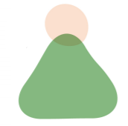
Architecture Decisions
Should we create Spring based Web App?
Should we create React Native App?
Hmm distributed architecture it has to be

Slide 7
Communicating your architecture decisions
For critical architecture decisions make sure the right stakeholders know about the decision
Frequent meetings with key stakeholders that can then communicate your decisions to others

Slide 8
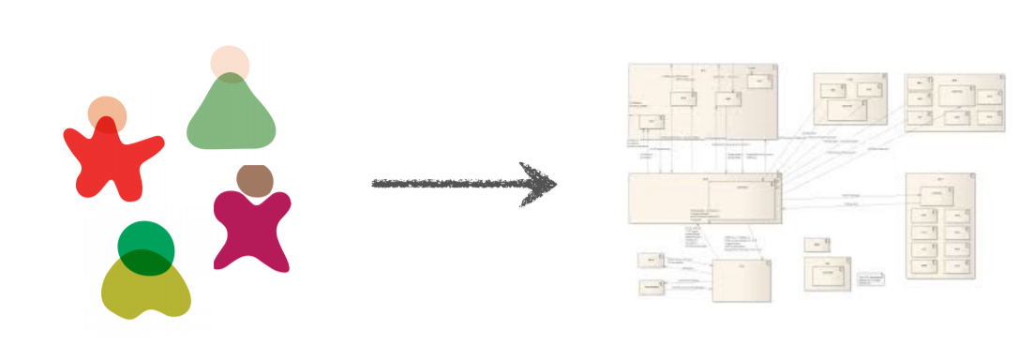
The goal
Using collective knowledge and experience to arrive at a unified vision of the architecture.

Slide 9
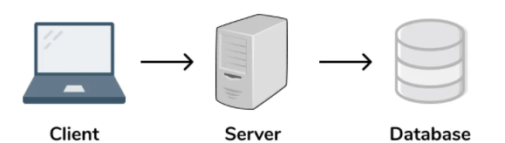
Different tiers in Application
Presentation Layer
Application Layer
Data Layer
Notes:
Presentation Layer
This tier, which is built with HTML5, cascading style sheets (CSS) and JavaScript, is deployed to a computing device through a web browser or a web-based application.
Application Layer
The application tier, which may also be referred to as the logic tier, is written in a programming language such as Java and contains the business logic that supports the application’s core functions. The underlying application tier can either be hosted on distributed servers in the cloud or on a dedicated in-house server, depending on how much processing power the application requires.
Data Layer
This tier is concerned with the storage and retrieval of application data. The application data is typically stored in a database server, that supports data access logic and provides the necessary steps to ensure that only the data is exposed .This is done by the data tier by providing an API to the application tier.

Slide 10
Benefits of 3 tier Architecture
Faster development
Improved scalability
Improved reliability
Improved security
Notes:
Faster development: Because each tier can be developed simultaneously by different teams, an organization can bring the application to market faster, and programmers can use the latest and best languages and tools for each tier.
Improved scalability: Any tier can be scaled independently of the others as needed.
Improved reliability: An outage in one tier is less likely to impact the availability or performance of the other tiers.
Improved security: Because the presentation tier and data tier can't communicate directly, a well-designed application tier can function as a sort of internal firewall, preventing SQL injections and other malicious exploits.

Slide 11

Front-end Technologies
Everything involved with
what the user sees including
design
Consists of different languages
and libraries

Slide 12
Some Front-end Technologies
React for a Responsive Web Front-End Development
Angular Front-End Development
Vue.js Web App Front-End Development
Flutter for Cross-Platform Mobile and Web Front-End Development
Ionic for Cross-Platform Front-End Development
Bootstrap CSS Framework
TypeScript for Web Front-End Development
React Native Cross-Platform Mobile Front-End Development
HTML, CSS, JavaScript
Notes:
https://www.icicletech.com/blog/top-front-end-development-technologies
React
React is an open-source front-end library licensed and released under MIT in 2013. React is probably the most used front-end technology and has greatly improved with every update.
React’s code is split into components to facilitate code reusability and fast debugging. The applications built on React are highly responsive and amounts for SEO friendliness. The data binding also ensures a solid code structure and a seamless app performance.
Airbnb, Dropbox, BBC, Facebook, New York Times, and Reddit are some of the prominent websites and web apps built with React.
Angular
ngularJS is a JavaScript front-end development framework originally developed in 2009. It was licensed under MIT as open-source and since that time, AngularJS has gained immense popularity for its advantages.
Angular is maintained by the search engine powerhouse, Google, and supported by a huge community of developers.
Angular uses MVVM architecture making it easy to maintain and refactor the codes. The component-based architecture further ensures a higher quality of code and eases testing.
The JavaScript front-end framework is consistent, readable, and its apps are performing well in various industries.
Netflix, Upwork, IBM, Goodfilms, and Freelancer are some of the renowned websites built with Angular. Gmail, Paypal, and The Guardian are some of the well-known applications built with Angular.
Vue.js
Vue.js is a JavaScript framework released in 2014 and licensed as open-source under MIT. The front-end development technology is highly promising and is expected to lead the front-end development.
The framework maintained by its creator Evan You and a team comprising members from various companies like Netguru and Netlify.
Vue.js uses MVVM architecture and is extremely lightweight making it easy to implement.
Some of the websites and apps built with Vue.js are 9gag, Nintendo, GitLab, Behance, and Laravel. The websites indeed exhibit the prowess of the framework.
Flutter
Flutter is a cross-platform and open-source UI software development toolkit released by Google to create beautiful and responsive User Interfaces.
It is licensed under BSD clause-3 and was released in 2017 for wide incorporation. Flutter is built on Dart and puts the language’s advantages to good use in the applications.
Flutter uses the combination of widgets to create UI that is visually enticing and highly reactive. And it doesn’t have any compatibility issues as the widgets are a part of the application.
Flutter’s hot reload increases the speed of the development and makes it simple. Hot reload applies the code changes to the application without having to reload.
The performance is also top-notch as there is less mediation between the platform and the app.
Google ads, Alibaba, Birch Finance, Cryptograph, and Hookle are some of the applications powered by Flutter.
Ionic
Ionic is an open-source front-end framework to build beautiful and fast cross-platform apps compatible with iOS, Android, and the Web using a single codebase.
Ionic was released in 2013 under the MIT license and maintained by the developers of Drifty Co. It is also backed by a global community of around 5 million developers.
Ionic is simple and leans towards speed, cost-efficiency, and less maintenance to help businesses grow.
The National Health Service, GE Transportation, Market Watch, and Amtrak are some of the examples of business built on Ionic.
Bootstrap
Bootstrap was released on 19th August 2011 under MIT license. It is an open-source CSS framework to build dynamic websites and web applications. It is built by Mark Otto at Twitter as a framework for consistency.
Bootstrap, as a front-end development framework, allows websites to be highly responsive with its fluid grid layout and gives a mobile-ready platform perfect for all the devices.
Bootstrap ensures front-end development consistency for developers and designers. The CSS framework has also got the support of a strong community.
Typescript
TypeScript is also an open-source programming language with Apache License 2.0. It was developed and maintained by Microsoft and shares the semantics with JavaScript.
TypeScript comes with a good stack of advantages for front-end development. The apps built with TypeScript are super scalable and will assist greatly in the long run. They are also faster and quick to respond.
With TypeScript, there are fewer bugs to worry about, the app is easy to maintain and codes can be refactored without any complications.
ReactNative
React Native was announced in February 2015 and was released as open-source under MIT License.
The front-end development framework was created by the social media giant, Facebook. It is the optimal cross-platform development framework delivering a superior app performance.
The component-driven front-end technology makes it easy for the developers with code reusability and testability Hot reloading further increases the speed of development by reducing the waiting time to view the changes.
React Native also has a huge community support and is updated regularly to add more features.

Slide 13
Back-end Technologies
Back-End
Refers to the server-​side
development.
Focuses on databases, scripting,
website architecture.

Slide 14
A Back-end Developer should know
Web Development Languages
Database and Cache
Server
API (REST & SOAP)

Slide 15
Some Back-end Technologies
JavaScript
PHP
Ruby
Java
C#(.NET)
C++
C
Scala
Golang
Notes:
https://glossarytech.com/terms/back_end-technologies

Slide 16
Best practices to follow as Front-End Developer
Build interfaces that follow every minute detail of the provided designs: in layouts, colors, typography, spacing, and more.
Teams should thoroughly discuss all UI and UX peculiarities of a given product, even before the designers get to their digital canvases.
Use popular front end CSS frameworks, like Bootstrap, Foundation, or Material Design to speed up graphical UI development.

Slide 17
Best practices to follow as Back-End Developer
Version Control using GIT
Automate repetitive tasks using scripts
Make scalable solutions
Manage schema changes
Monitor health of the solution
Choose Best hosting solution
Notes:
https://levelup.gitconnected.com/some-best-practices-to-take-note-as-a-backend-developer-ce95ee0a3a43

Slide 18
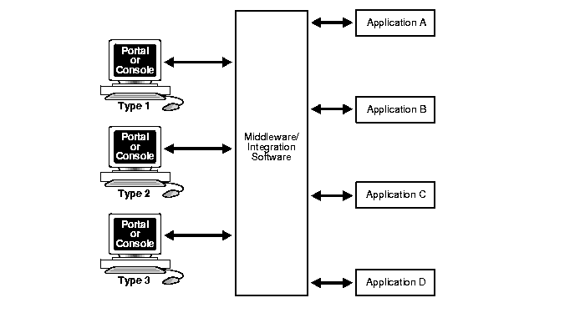
Front-end Integration
In this implementation, middleware or a similar integration solution intercepts interactions between applications. The middleware acts as a middle tier application server: transparently marshaling, managing, and directing interapplication requests and responses. Typically, the requesting application waits while the middleware requests services of another application.
Notes:
https://docs.oracle.com/cd/A87860_01/doc/ois.817/a83729/adoisap2.htm
ront-end integration solutions generally display some, or all, of these characteristics:
Interaction between the integration layer and the applications is:
Synchronous, or simulates synchronous processing
Two-way communication based on a service request model
Transactions processed are of short duration.
The application (user) is not aware of using the services of multiple disparate applications.
Middleware behaves like a midtier application server: marshaling, managing, and directing requests and responses and managing transactional and recovery issues.
Front-end integration has both advantages and disadvantages.
Advantages
You can develop a number of presentation layers for different user, customer, and supply channels.
All presentation layers share the same services, thus ensuring consistent interactions regardless of channel.
Each presentation layer requires only one signon to access all required functionality.
Drawbacks
Applications must meet these criteria to participate in the interactions:
All functionality must be offered through a service-based API.
All business and data logic must be separate from the presentation layer.
The transaction/commit model must act as a resource manager in the chosen multiphase commit processing.
Few legacy and currently available ERP/CRM packages meet these criteria, so you probably must develop a custom application.
The presentation layer of packaged applications is unlikely to be usable. This may lead to difficulties in providing support, lengthy implementation time, and so on.
It is difficult to manage a development and testing environment because of the need for a complex architecture, the lack of suitable strong tools, and the dependence on program-oriented delivery

Slide 19
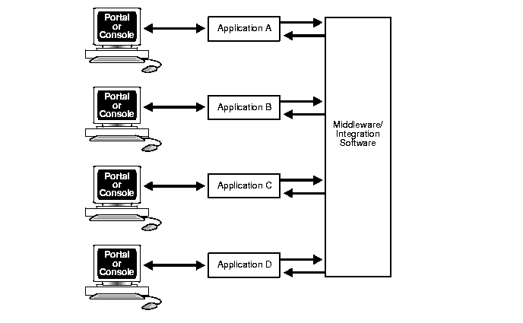
In this implementation, users interact with only one application at a time in a manner determined by their user roles.The application notifies other applications as necessary of the significant aspects of the user interaction. Application-to-application interactions can be based on further sequential notifications.
Notes:
Back-end integration solutions display some or all of these characteristics:
Interaction between the integration layer and the applications is:
Predominantly asynchronous
One-way communication
Service-request and event-notification models are both used.
Business process definitions closely mirror the business, and consequently transactions take a long time.
The user interacts with a single application or with a small number of applications.
The integration solution acts transparently as a sophisticated distribution and synchronizing agent.
Advantages
The presentation layer interface to the applications need not employ the same architecture as the applications.
You can use the prebuilt presentation layer delivered with packaged applications.
The business and data logic in an application need not be separate from the delivered presentation layer.
It is easy to manage the development and testing environments because asynchronous breakpoints provide natural testing points.
Graphical tools are provided to ease development.
Drawbacks
Each application has a different look and feel and a different signon, which makes applications appear to be only loosely integrated.
The user interface is narrowly constrained, thus restricting users who act in multiple and diverse roles.

Slide 20
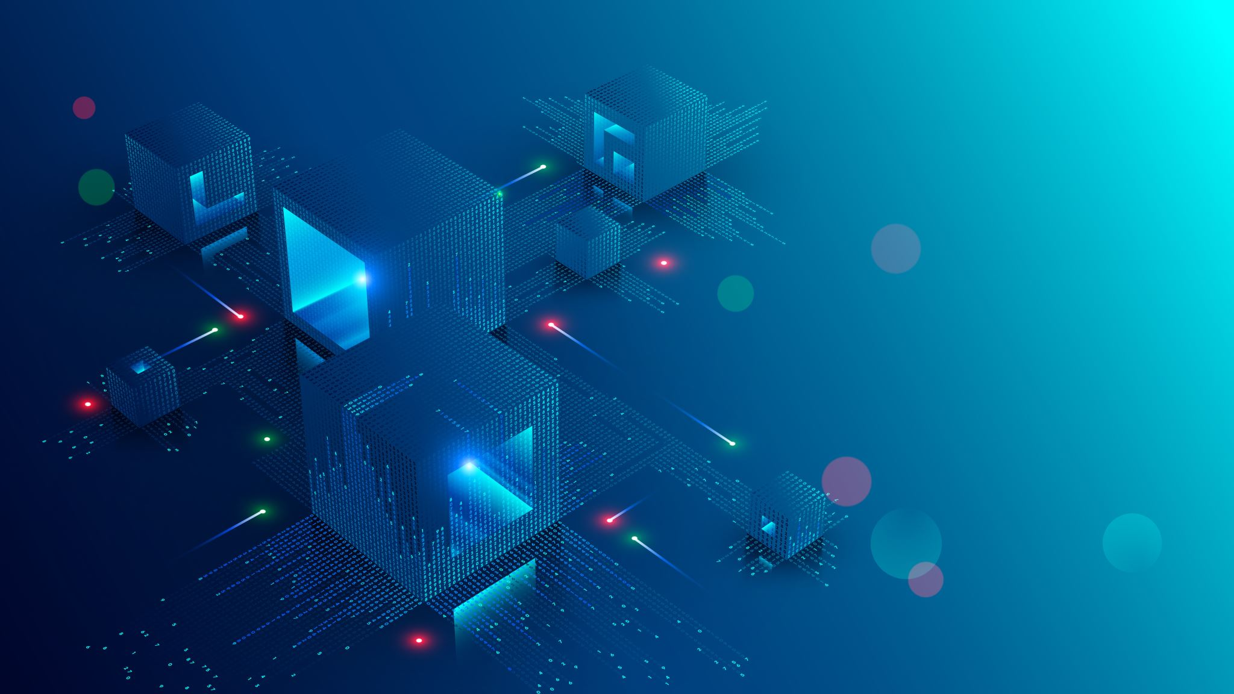
Summary
Introduction to Software Architecture
Front-End Technologies
Back-End Technologies
Integration of Front-End technologies
Integration of Back-End Technologies
Best Practices

Slide 21
Thank You!

